Slide 1
5. We perform a multi slit experiment, using 4 slits. The wavelength of the light is 500 nm and the distance of the screen from the slits is 10m.
a. Determine the distance of the slits, if the 3rd and 4th order diffraction fringes are 10 mm away from each other.
b. How many mayor and minor fringes are visible on the diffraction pattern if the coherence length of the light is 3 μm?

Slide 2
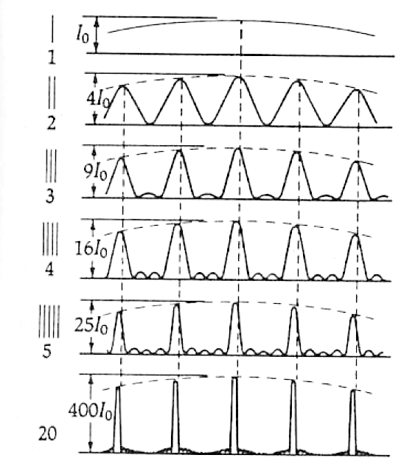
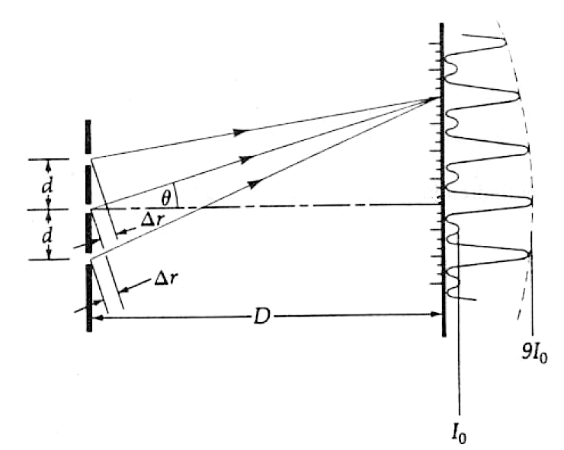





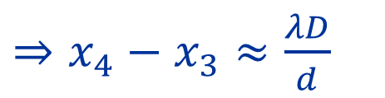
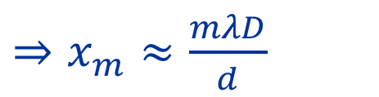

$N_{slit}=4$
Source of figures: Hudson-Nelson: Útban a modern fizikához
$λ=500nm=5⋅{10}^{−7}m$
$D=10m$
$x_{4}−x_{3}=10mm={10}^{−2}m$
$mλ=d⋅\sin{θ}$
$$mλ≈d⋅\frac{x_{m}}{D}$$
$\sin{θ}≈\operatorname{tg}{θ}=\frac{x}{D}$
$⇒x_{m}≈\frac{mλD}{d}$
$⇒x_{4}−x_{3}≈\frac{λD}{d}$
$⇒d≈\frac{λD}{x_{4}−x_{3}}=\frac{5⋅{10}^{−7}⋅10}{{10}^{−2}}=5⋅{10}^{−4}m=0.5mm$

Slide 3
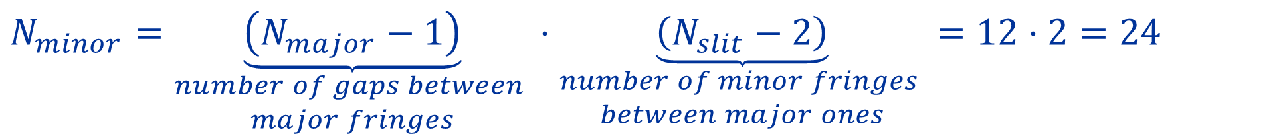



$N_{slit}=4$
Source of figures: Hudson-Nelson: Útban a modern fizikához
$λ=500nm=5⋅{10}^{−7}m$
$D=10m$
$δ=3μm=3⋅{10}^{−6}m$
$m_{max}=\frac{δ}{λ}=\frac{3⋅{10}^{−6}}{5⋅{10}^{−7}}=6$
$m$ goes from $−m_{max}$ to $m_{max}$
$⇒N_{major}=2⋅m_{max}+1=13$
$N_{minor}=\underset{\begin{aligned}number of gaps between \\ major fringes\end{aligned}}{\underbrace{\left(N_{major}−1\right)}}⋅\underset{\begin{aligned}number of minor fringes \\ between major ones\end{aligned}}{\underbrace{\left(N_{slit}−2\right)}}=12⋅2=24$

